Slide 1
Memory Hierarchy
CMP-334 Computer Organization

Slide 2
Memory Hierarchy… What’s that?
A structure that uses multiple levels of memories; as the distance from the processor increases, the size of the memories and the access time both increase

Slide 3
Explain that please
It just means...
memory that it is close to the processor it is faster to access
but it’s size is smaller compare to memory farther away from the processor
It’s how we implement the principle of locality

Slide 4
What is the principle of locality?
programs access a relatively small portion of their address space at any instant of time
programs tend to reuse data and instructions they have used recently
the awesome library analogy

Slide 5
Principle of locality… tell me more
it allow us to create an illusion…
of a large memory that we can access as fast as a very small memory
there are two different types of locality
temporal (time) : reference item again soon
spatial (space) : reference item nearby soon

Slide 6
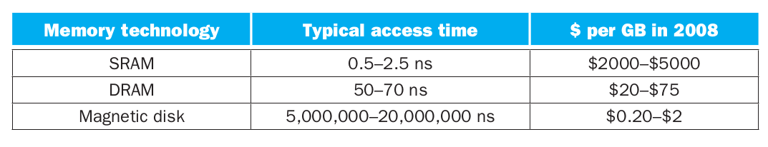
What does it looks like?
flash memory is used instead of disks in many embedded devices

Slide 7
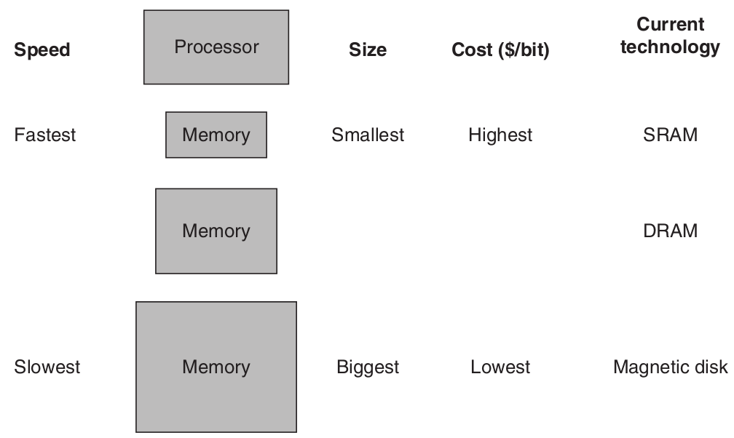
Another look...

Slide 8
How can data from the larger memory fit in the smaller memory?
the smaller level is generally a subset of any level further away
all the data is stored at the lowest level (furthest away from the processor)
in the library analogy the books at your desk are a subset of the books in the library

Slide 9
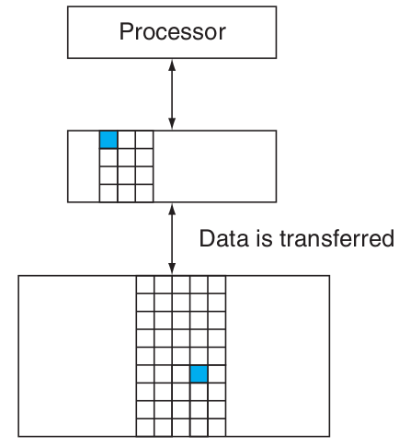
How is the processor getting data stored in the memory hierarchy?
data is copied between only two adjacent levels at a time
minimum data is called a block or line
if data requested by the processor is found its called a hit otherwise it is a miss

Slide 10
More hits is better… right?
that’s right
that’s how we measure performance of the memory hierarchy
hit rate is the fraction of memory accesses found in the upper level
miss rate (1 - hit rate) is the fraction of memory accesses not found in the upper level

Slide 11
Its about performance, isn’t it?
yes performance is the major reason for having memory hierarchy therefore...
the time to service hits and misses is important
hit time is the access time including time to figure out if it is a hit or a miss
miss penalty is the time to replace a block plus the time to delivery it to the processor

Slide 12
Ok, so the highest level is the fastest and the lowest level is the largest...
that’s correct
the first commercial computer called this highest level memory a cache
the term cache is also used to refer to any storage managed to take advantage of locality

Slide 13
How do we know if a data item is in the cache?
good question
and if it is, how do we find it?
the simplest way is to assign a location in the cache based on the address in memory

Slide 14
How do you do that?
by directly mapping the memory location to exactly one location in the cache
we call this cache structure direct mapping
so to find a block we use this mapping
(block address) modulo (# of blocks in cache)

Slide 15
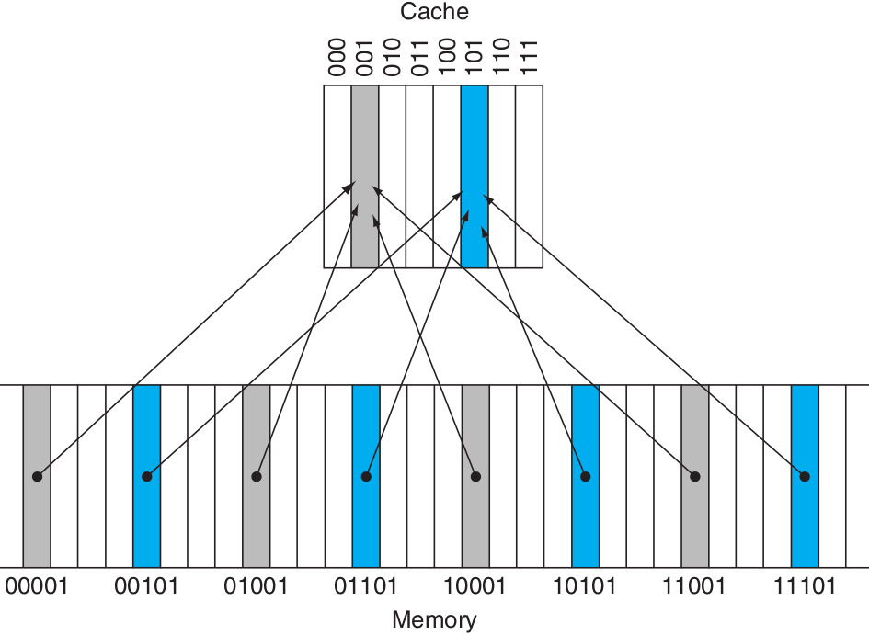
Show me please
8 words in cache
memory address X direct-mapped
X modulo 8
one block maps to many memory entries

Slide 16
How do we know if requested word is in the cache?
by adding tags to the cache
tags contain address information
only the bits not used as index into the cache
we also need a valid bit; some way to indicate that the block contains valid data

Slide 17
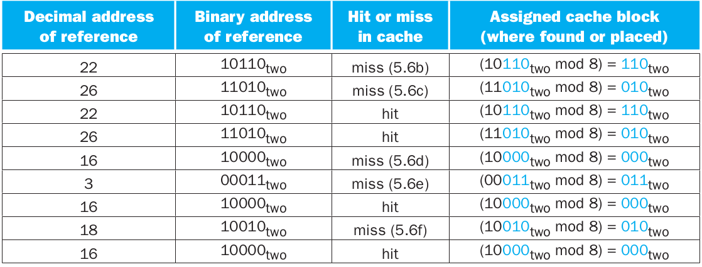
Show me an example please...
address 18 should be brought into cache block 2

Slide 18
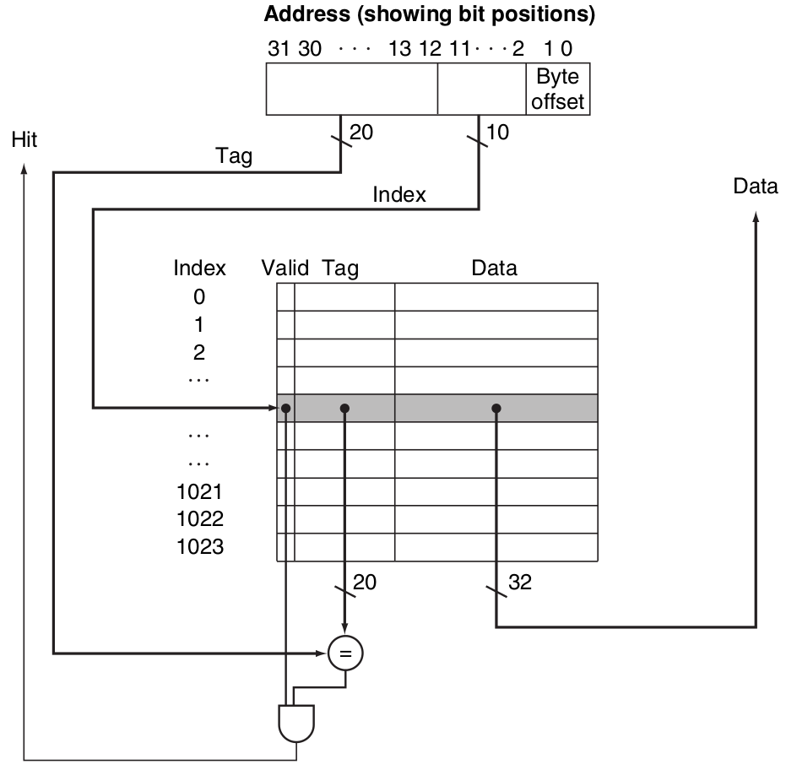
Where is the tag and valid bit?
32-bits address
cache size 2^{n} blocks
1024 words or 4KB
block size is 2^{m} words
tag size
32 - (n + m + 2)
total number of bits in a direct-mapped cache
2^{n} x (2^{m} x 32 + (32 - n - m - 2) + 1)

Slide 19
That was a one word block, right?
yes correct very small block
larger blocks exploits spatial locality to lower miss rates
spatial locality among words in a block decreases with a very large block
miss penalty will likely increase as the block size increases

Slide 20
How do we handle misses?
we need to modify the control unit
control unit must detect a miss and process the miss by fetching the data from memory
cache miss creates a pipeline stall as opposed to an interrupt, which require saving state of all registers

Slide 21
How is the control unit modified?
we add hardware to handle to following steps:
instruction cache miss (data is identical)
send original PC value (PC-4) to memory
instruct memory to perform read
wait
wait
wait
write the cache entry (data, tag, valid bit on)
restart instruction execution, which will refetch the instruction, this time finding it in the cache

Slide 22
How do we handle write to memory?
we must write data to cache and main memory
otherwise they will be inconsistent
the simplest way is to write both cache and memory at the same time
this scheme is called write-through

Slide 23
Wouldn’t that be slow?
yes, it will affect performance
one solution is to use a write buffer
write buffer is freed after completing main memory write
alternative to write-though is a scheme called write-back

Slide 24
How does write-back works?
update value only to the block in the cache
it writes to the lower level when the block is replaced

Slide 25
How do we compare write-through versus write-back writing policies?
let’s start with write-through advantages
easy to implement
consistent (main memory always updated)
read miss never results in write to main memory

Slide 26
disadvantages?
write-through disadvantages
slow
every write access main memory
uses more memory bandwidth

Slide 27
How about write-back?
write-back advantages
writes occurs at cache memory speed
multiple writes within a block require only one write to main memory
less memory bandwidth

Slide 28
What are the disadvantages?
write-back disadvantages
hard to implement
main memory is not always consistent with cache
stores either require two cycles or a write buffer to hold that data
reads that result in replacement may cause writes of dirty blocks to main memory

Slide 29
Any example cache implementation?
yes
the Intrinsity FastMATH processor
a 12-stage pipeline fast embedded microprocessor that uses MIPS architecture and a simple cache implementation
it uses a split cache

Slide 30
What is a split cache?
a scheme in which a level of the memory hierarchy is composed of two caches that operates in parallel
it could request both an instruction and data on every clock cycle
CPU can be reading data from one cache while simultaneously loading an instruction

Slide 31
Does split cache improves performance?
yes, it also increases cache bandwidth
but, the miss rate is slightly worse
simplifies the design too
decoder and scheduler are only hooked to the instruction cache
registers and ALU and FPU are only hooked to the data cache

Slide 32
You keep mentioning bandwidth… How do we improve bandwidth?
organizing memory differently
increasing the number of bytes transferred per bus clock cycle
we will discuss three memory system design options

Slide 33
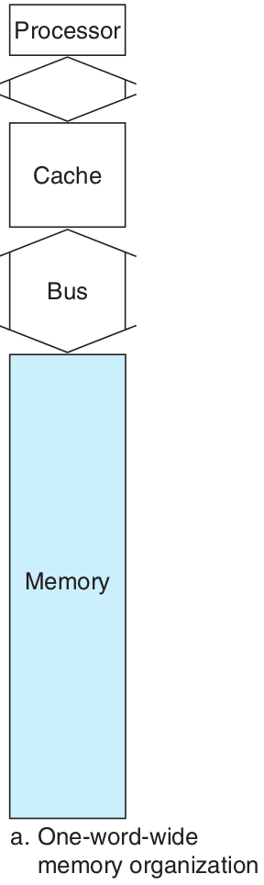
memory is one word wide
access made sequentially
simplest design

Slide 34
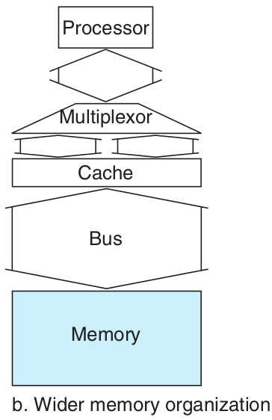
increases the bandwidth to memory
wider memory, bus and cache
allows parallel access to multiple word of the block
multiplexor used on reads and control logic to update words of the cache on writes

Slide 35
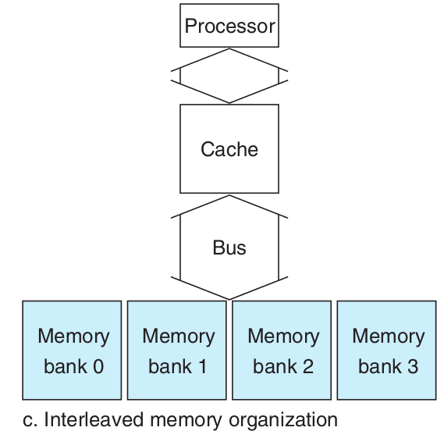
increases the bandwidth to memory
narrow bus and cache with an interleaved memory

Slide 36
How do we measure and improve cache performance?
to measure it we need to look at CPU time
CPU time can be divided into the clock cycles that the CPU spends executing the program and the clock cycles that the CPU spends waiting for the memory system
CPU time =
(CPU execution CC + Memory-stall CC) x Clock cycle time

Slide 37
Oh yes memory stall clock cycles
yes, primarily from cache misses
but we are simplifying it here for our discussion
stalls generated by reads and writes can be quite complex
Memory-stall clock cycles =
Read-stall cycles + Write-stall cycles

Slide 38
So, we need to account for both hits and misses?
yes, both hits and misses affects performance
designers sometime use a formula as a way to examine alternative cache designs
AMAT =
Time for a hit + Miss rate + Miss penalty
Average Memory Access Time

Slide 39
Can you show an example?
Find the AMAT for a processor with a 1 ns clock cycle time, a miss penalty of 20 clock cycles, a miss rate of 0.05 misses per instruction, and a cache access time (in­cluding hit detection) of 1 clock cycle. Assume that the read and write miss penalties are the same and ignore other write stalls.
AMAT = 1 + 0.05 x 20 = 2 clock cycles = 2ns

Slide 40
AMAT is affected by miss rate. Any other way to help us decrease it?
we could use a different cache structure
so far we have used a simple placement scheme
direct mapping, a block in exactly one location
that’s one extreme, the other scheme is fully associative

Slide 41
fully associative?
a block in memory may be associated with any entry in the cache
need to search all entries in the cache to find a given block
to make it practical, search is done in parallel with a comparator associated with each cache entry

Slide 42
that’s extreme...
true
the middle range is set associative
fixed number of locations where each block can be placed
n locations for a block is called n-way set-associative cache
just a number of sets, each of which consists of n blocks

Slide 43
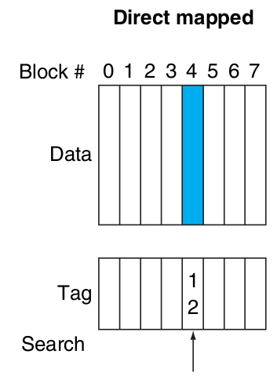
Show me please
a block in exactly one location
(block number) modulo (Number of blocks in the cache)
only one cache block where memory block 12 can be found
12 modulo 8 = 4

Slide 44
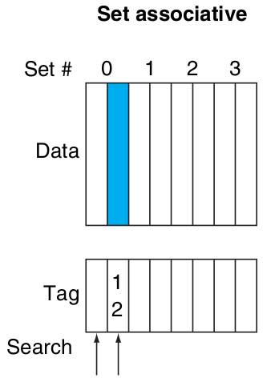
Set associative
a block in exactly one location
(block number) modulo (Number of blocks in the cache)
only one cache block where memory block 12 can be found
12 modulo 8 = 4

Slide 45
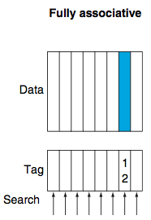
Fully associative
a block in memory associate to any cache block
searching all entries
memory block 12 could be anywhere

Slide 46
Any advantage in any of them?
increasing the degree of associativity usually decreases the miss rate
the main disadvantage is a potential increase in the hit time

Slide 47
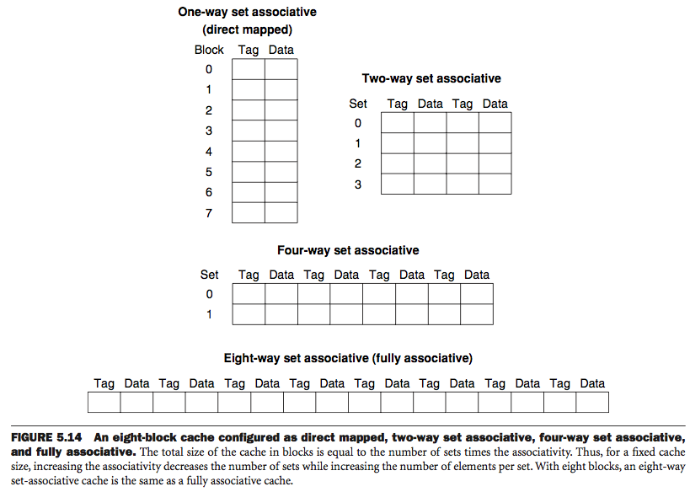
How does that look?

Slide 48
How do you locate a block in the set associative cache?
just as in direct-mapped cache, each block includes an address tag
index is used to select the set
all tags on a set must be searched
but they are all searched in parallel

Slide 49
How about fully associative?
its effectively only one set
all blocks must be checked in parallel
there is no index
entire address, except block offset compared against tag of every block
we search entire cache without any indexing

Slide 50
If all blocks are used, how do we decide which one to replace?
good question
the most common scheme is least recently used (LRU)
for two-way set-associative we keep a single bit indicate latest element
it gets harder as associativity increases

Slide 51
What’s the best choice?
the choice among direct-mapped, set-associative, or fully associative mapping depends on the cost of a miss versus the cost of implementing associativity, both in time and in extra hardware.
direct-mapped needs a single comparator
4-way set-associative needs 4 plus 4-to-1 mux

Slide 52
How do we reduce the miss penalty?
we use multilevel caches
additional level of caching used to close the gap between fast clock cycle of processor and time required to access DRAM
second-level cache usually on the same chip and accessed whenever a miss occurs in the primary cache

Slide 53
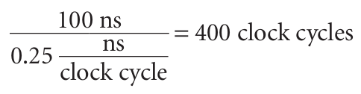
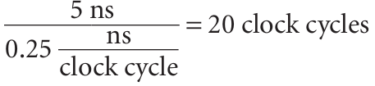
An example please…
Suppose we have a processor with a base CPI of 1.0, assuming all references hit in the primary cache, and a clock rate of 4 GHz. Assume a main memory access time of 100 ns, including all the miss handling. Suppose the miss rate per instruction at the primary cache is 2%.
How much faster will the processor be if we add a secondary cache that has a 5 ns access time for either a hit or a miss and is large enough to reduce the miss rate to main memory to 0.5%?
miss penalty to main memory
processor with one level caching
Total CPI = 1.0 + Memory-stall CPI
= 1.0 + 2% x 400 = 9
miss penalty to second-level cache
processor with two level caching
Total CPI = 1.0 + Primary. + Secondary stalls
= 1.0 + 2% x 20 + 0.5% x 400 = 3.4
processor is faster by 9.0/3.4 = 2.6

Slide 54
So, the main memory can act as a “cache” for the secondary storage?
do you mean a cache to magnetic disk?... yes
this technique is called virtual memory
it allows efficient and safe sharing of memory among multiple programs
it also removes the programming burdens of a small limited memory… not longer true

Slide 55
Programs share memory?
yes, but they don’t know about each other
programs sharing memory change dynamically while the program is running
therefore we would like to compile each program into its own address space
address space is a separate range of memory locations accessible only to the program

Slide 56
An address space with range of location?
yes, virtual memory implements the translation of a program’s address space to physical addresses
this process enforces protection of a program’s address space from other programs
protection is a set of mechanism ensuring that multiple process sharing processor, memory or I/O devices cannot interfere with one another

Slide 57
Is there another motivation for virtual memory?
yes, it also allows a single user program to exceed the size of primary memory
programmers used to divide programs into pieces
loading and unloading overlays during execution
making sure overlays never exceeded the total size of the memory

Slide 58
That sounds like a lot of work for the programmer...
that’s right, virtual memory was invented to relieve programmers from this burden
virtual memory automatically manages the two levels of the memory hierarchy represented by main memory and secondary storage
same concepts as cache but we use different terminology

Slide 59
Different terminology?
a virtual memory block is called a page
a virtual memory miss is called a page fault
the processor produces a virtual address, which is translated by hardware and software to physical address
virtual address with pages are mapped to main memory
this process is called address mapping or address translation

Slide 60
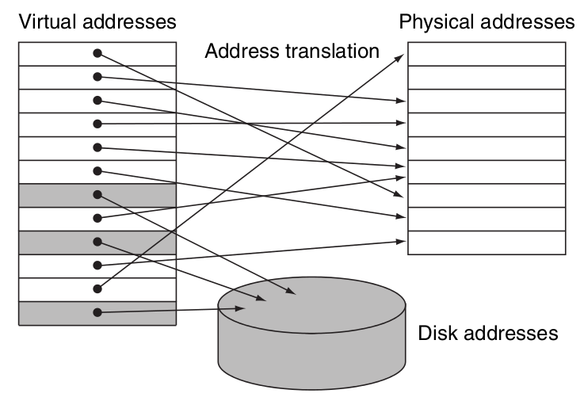
Can you show me?
In virtual memory, blocks of memory (pages) are mapped from one set of addresses (virtual addresses) to another set (physical addresses)
processor generates virtual addresses while memory is accessed using physical addresses
virtual page mapped to physical page
physical page can be shared by having two virtual addresses point to the same physical address

Slide 61
So, it simplifies loading a program?
that’s correct, it simplifies loading a program for execution by providing relocation
relocation maps the virtual addresses used by a program to different physical addresses before addresses are used to access memory
it means we could load a program anywhere in main memory
programs relocated as fixed-size blocks (pages)

Slide 62
How is the address broken?
the address is broken into a virtual page number and a page offset
virtual page number translate to a physical page number
physical page number is the upper portion of the physical address
the page offset is the lower portion

Slide 63
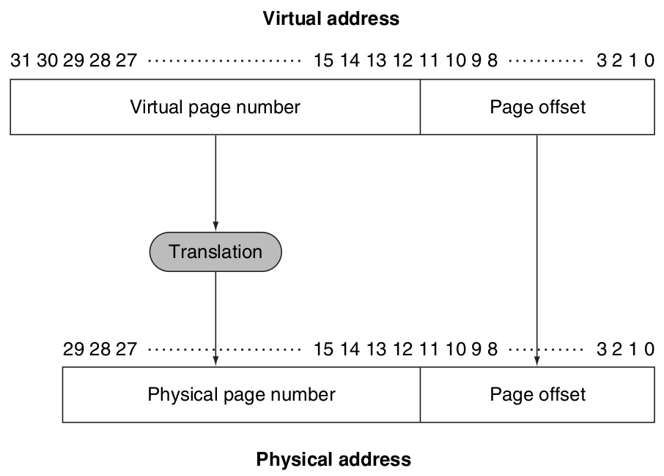
How does it look?
page size is 2¹² = 4KB
2¹⁸ physical pages in memory
thus, main memory can have at most 1 GB
while virtual address space is 4GB

Slide 64
A miss must take a lot of cycles?
in virtual memory is called a page fault
a page fault could take millions of clock cycles to process
this enormous miss penalty leads to several key decisions in designing virtual memory

Slide 65
What decisions?
pages are made large to take advantage of spatial locality and to reduce miss rate
fully associative placement of pages in memory
operating system uses techniques, such as LRU and a reference bit, to choose which page to replace
writes to disk are expensive, so it uses write-back also tracks page unchanged

Slide 66
How do we place a page and find it?
page fault high penalty requires that we optimized page placement
OS can use a sophisticated algorithm and complex data structures that track page usage
we locate pages using a table that indexes the memory; this structure is called a page table
it resides in memory and it is indexed with the page number from the virtual address

Slide 67
How do we know the location of the page table in memory?
the hardware includes a register that points to the start of the page table
its called the page table register
the page table, the program counter and the registers specify the state of a program
this state is also referred to as a process

Slide 68
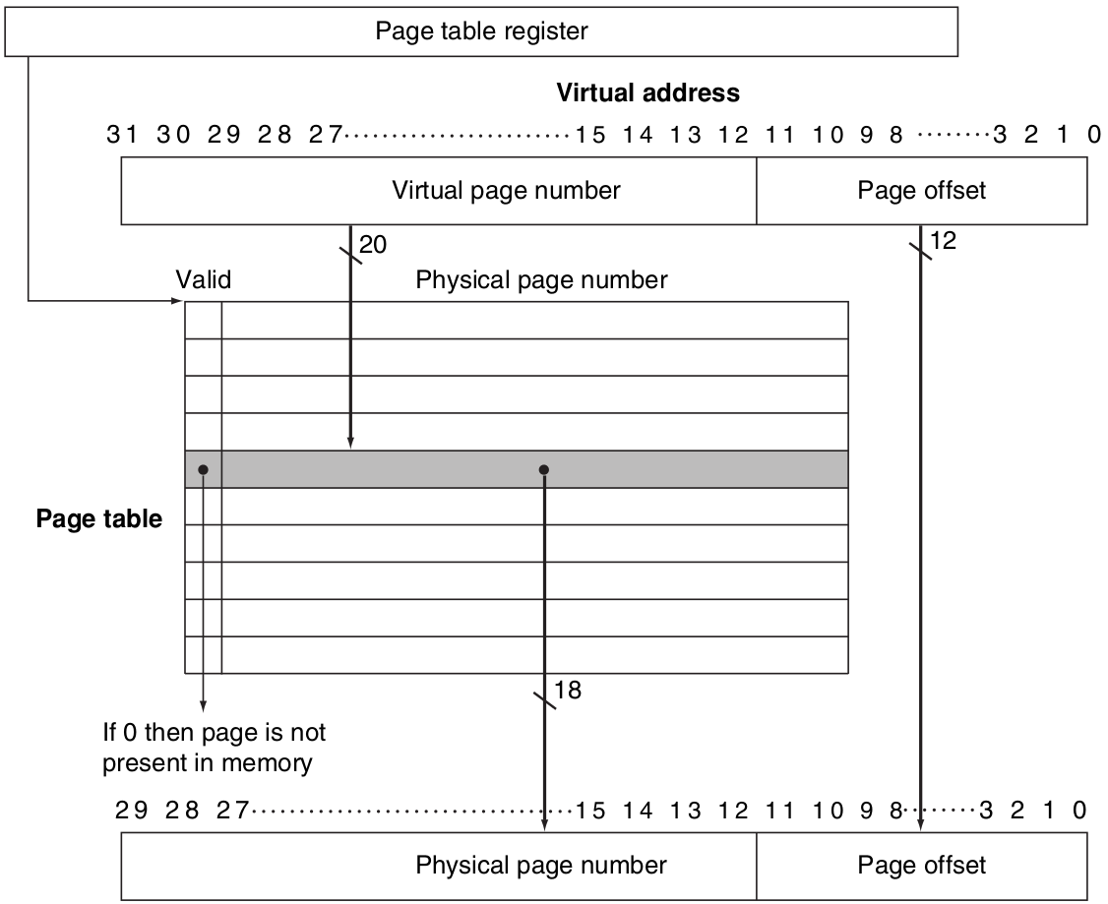
Show me…
page table is indexed with virtual page number to obtain the corresponding portion of the physical address
valid bit indicates whether mapping is legal
extra bits used to store additional information that needs to be kept on a per-page basis, such as protection

Slide 69
So, if the valid bit is off a page fault occurs?
that’s right and the operating system must be given control
the OS must find the page in the next level of the hierarchy and decide where to place the requested page in main memory
it also creates a space on disk for all the pages of a process, this disk space is called the swap space

Slide 70
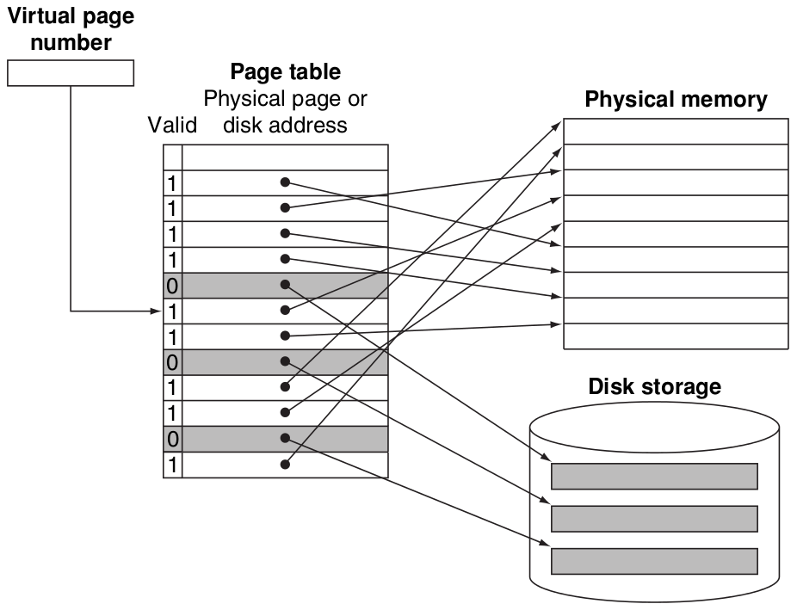
Show me…
page table maps each page in virtual memory to either a page in main memory or a page stored on disk
if valid bit is on, the page table supplies the physical page number corresponding to the virtual page
if valid bit is off, the page currently resides only on disk
pages in main memory and the pages on disk are the same size

Slide 71
How does the OS keep track of LRU pages?
some operating system provide a reference bit or use bit
reference bit is set whenever a page is accessed
the OS clears the reference bits and later records them so it can determine which pages were used

Slide 72
How big can a page table get?
the page size for a 32-bit virtual address, 4KB pages, and 4 bytes per page table entry
number of page table entries = 2³²/2¹² = 2²⁰
size of page table = 2²⁰ page table entries x 2² bytes / page table entry = 4MB
it means we would need 4MB of memory for each program in execution at any time
not a lot but for a single program

Slide 73
What if there are hundreds?
we use a range of techniques to reduce the amount of storage required for the page table
simplest solution is to keep a limit register that restrict the size of the page table
page table grow as a process consumes more space
address space expand in only one direction

Slide 74
Any other techniques?
most languages require two areas (heap and stack) whose size is expandable
we will need two separate page tables and two separate limits
grow from highest address down and lowest address up
this type of segmentation is popular with many architecture including MIPS

Slide 75
Any other approach?
yes, reducing the page table size by applying a hash function to the virtual address
page table need be only the size of the number of physical pages in main memory
this structure is called inverted page table
lookup process is slightly more complex since we can no longer just index the page table

Slide 76
Any others?
yes, multiple levels of page tables can also be use to reduce the size of the page table
the first level maps large fixed-size blocks of virtual address space, called segments
also, to reduce the actual main memory tied up in page tables, modern systems allow the page tables to be paged

Slide 77
What about writes?
write-back scheme is a major advantage
disk transfer time is small compared to access time, copying entire page is more efficient
still costly
we need a dirty bit to know whether a page needs to be copied back
dirty bit is set when any word in a page is written

Slide 78
How about address translation can we make it faster?
since page tables are in main memory, every memory access take at least twice as long
one memory access to obtain the physical address and a second to get the data
to improve performance we rely on locality
modern processors include a special cache that keeps track of recently used translation
cache called translation-lookaside buffer (TLB)

Slide 79
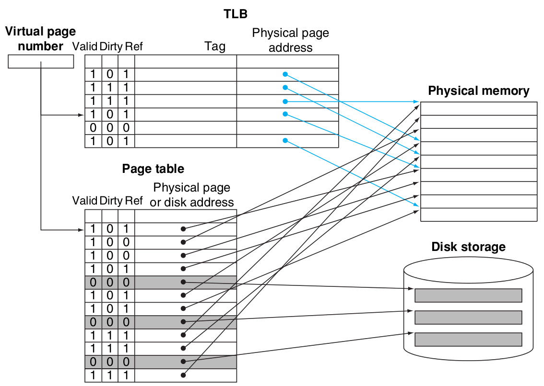
Show me…
TLB acts as a cache of the page table for the entries that map to physical pages only
TLB contains a subset of the virtual-to-physical page mappings
TLB is a cache so it must have a tag field
we access the TLB instead of the page table on every reference, hence the valid, dirty and ref bit

Slide 80
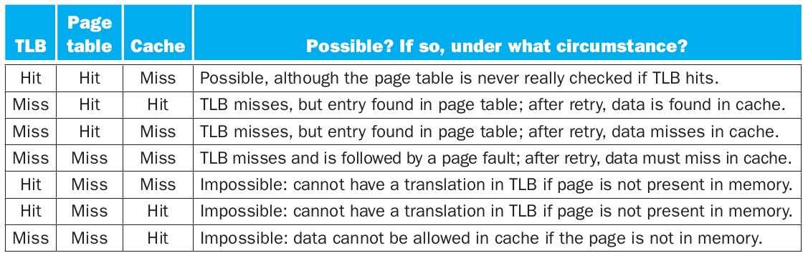
So, we have TLB, page table and cache…
yes, we could have 3 different types of misses

Slide 81
How do we implement protection in virtual memory?
the hardware must provide at least three basic capabilities
two modes to indicate if running process is a user process or an OS process, kernel process
portion of the processor state that a user process can read but not write
a mechanism to switch from user mode to supervisor or kernel mode

Slide 82
What happens when the OS decides to change to another process?
we need to change the internal state of the processor to allow a different process to use the processor
that means we need to save the state to be able to return to the currently running process
this is called a context switch

Slide 83
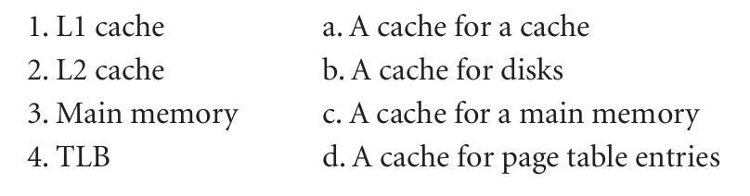
Ok…
quick check
match the memory hierarchy element

Slide 84
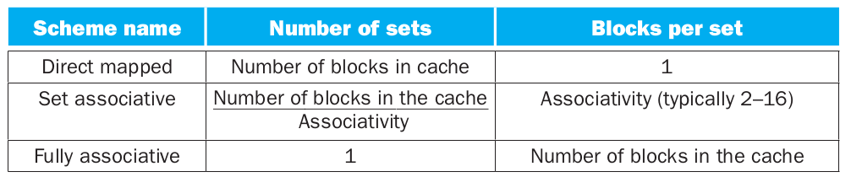
More please…
where can a block be placed?

Slide 85
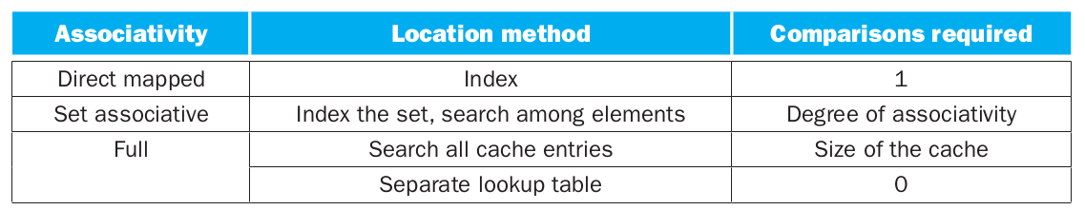
I like this…
how is a block found?

Slide 86
More please…
which block should be replaced on a cache miss?
two strategies used…
random: candidate blocks randomly selected
least recently used (LRU): the block replaced is the one that has been unused for the longest time

Slide 87
This is fun…
what happens on a write?
two basic options…
write-through: information is written to both the block in the cache and the block in the lower level of the memory hierarchy
write-back: information is written only to the block in the cache, copy to lower level only when it is replaced

Slide 88
Oh, What is Virtual Machine?
an idea related to virtual memory
important part of mainframes since mid-1960s
VMs includes basically all emulation methods that provide a standard software interface, such as the Java VM
two major classifications:
system virtual machines IBM VM/370, Xen
process virtual machines Java JVM

Slide 89
So, two types of VMs?
yes
system virtual machines present the illusion that the users have an entire computer to themselves, including copy of the OS
a single computer runs multiple VMs
a single OS “owns” all the hardware resources, but with a VM, multiple OSes all share the hardware resources

Slide 90
How does it work?
at the heart of the VM technology is the hypervisor or virtual machine monitor (VMM)
the underlying hardware platform is called the host
its resources are shared among the guest VMs
VMM determines how to map virtual resources to physical resources

Slide 91
The VMM has a lot to control?
to “virtualize” the processor, it must control just about everything
access to privileged state, address translation, I/O, exceptions, and interrupts
even as the guest VM and OS currently running are temporarily using them
so to be in charge the VMM must be at a higher privileged level than the guest VM

Slide 92
Does it need Instruction Set Architecture support?
good question
if VMs are planned for during design of the ISA, then the number of instructions executed by a VMM is reduce, improving emulation speed
IBM 370 architecture is an example of a virtualizable architecture, that is, it allows the VM to execute directly on the hardware

Slide 93
Pop Quiz

Slide 94
Which of the following is generally true about a design with multiple levels of caches?
1. First-level caches are more concerned about hit time, and second-level caches are more concerned about miss rate.
2. First-level caches are more concerned about miss rate, and second-level caches are more concerned about hit time.

Slide 95
Questions
How many 32-bit integers can be stored in a 16-byte cache line?
Compare and contrast the ideas of virtual memory and virtual machines. How do the goals of each compare? What are the pros and cons of each? List a few cases where virtual memory is desired, and a few cases where virtual machines are desired.
Notes:
A 32-bit integer is 4 bytes in size. A 16-byte cache line can store 4 32-bit integers.

Slide 96
Extra for those brave enough or for those that need to improve their grade….
Write a MIPS assembly program the ask the user for 2 integers, add and print result
Write exactly the same program above in C
due April 25

Slide 97
Extras

Slide 98
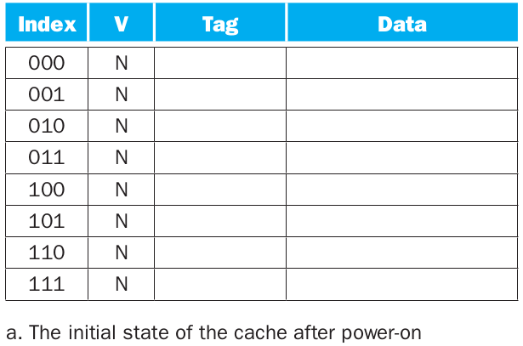
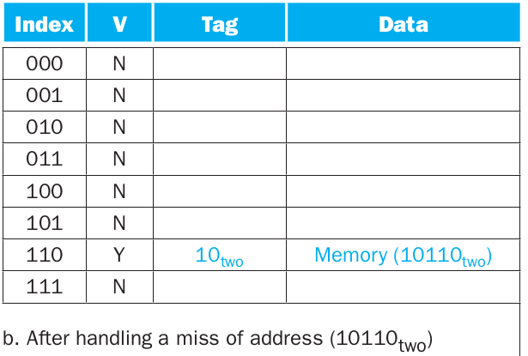

Slide 99
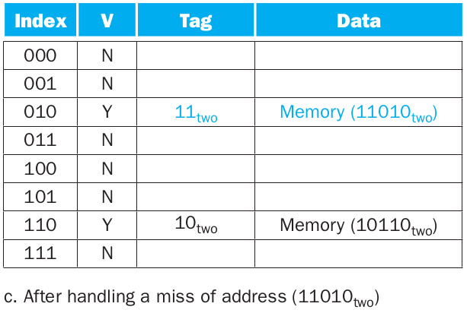
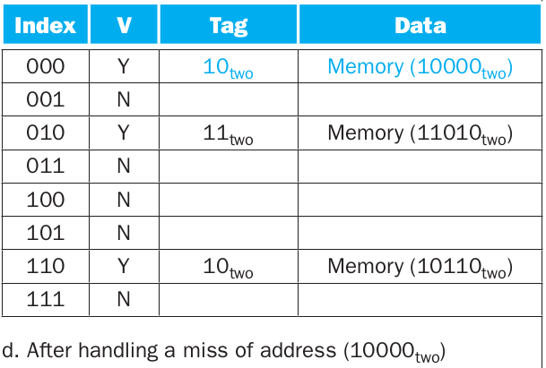

Slide 100
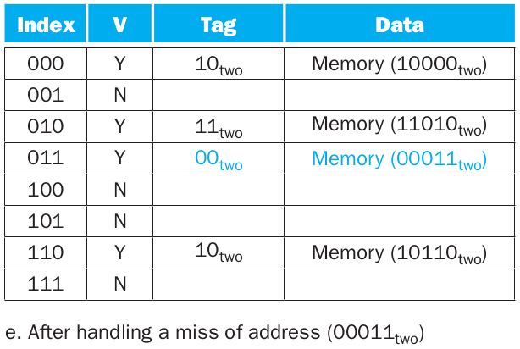
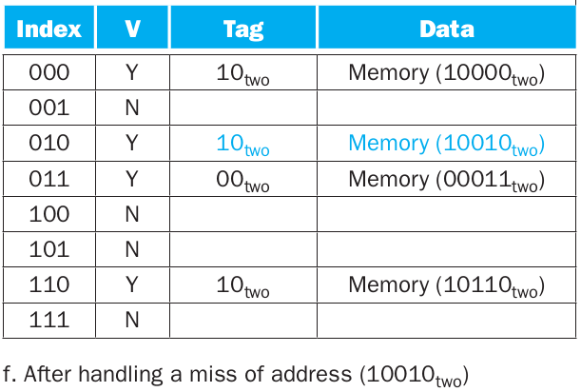

Slide 101
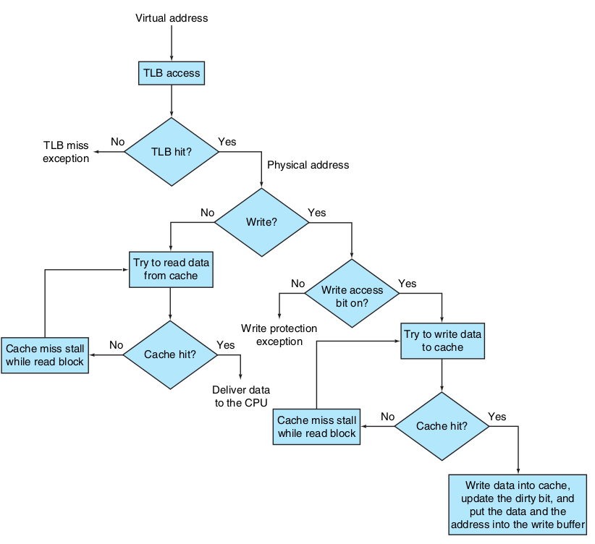

Slide 102
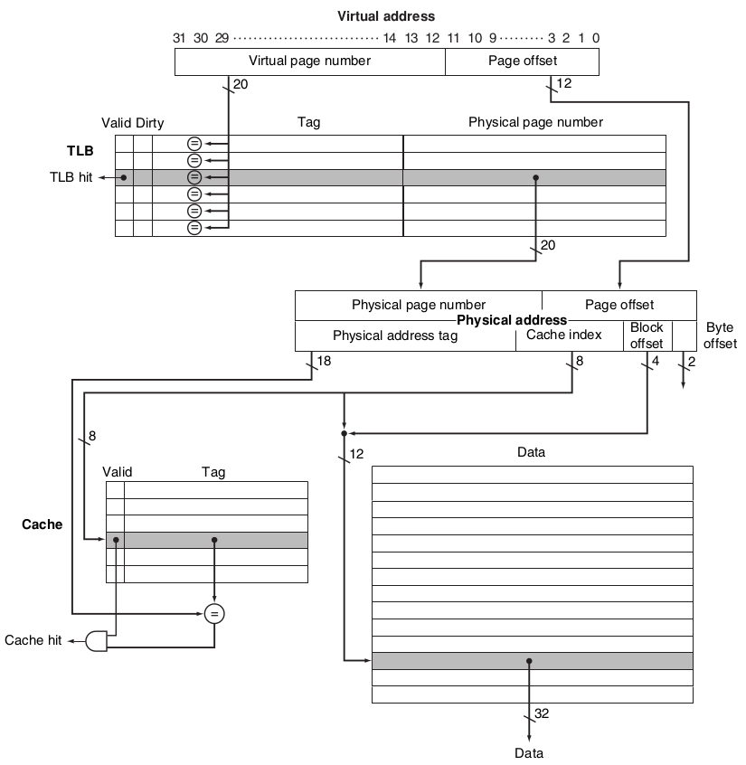

Slide 103
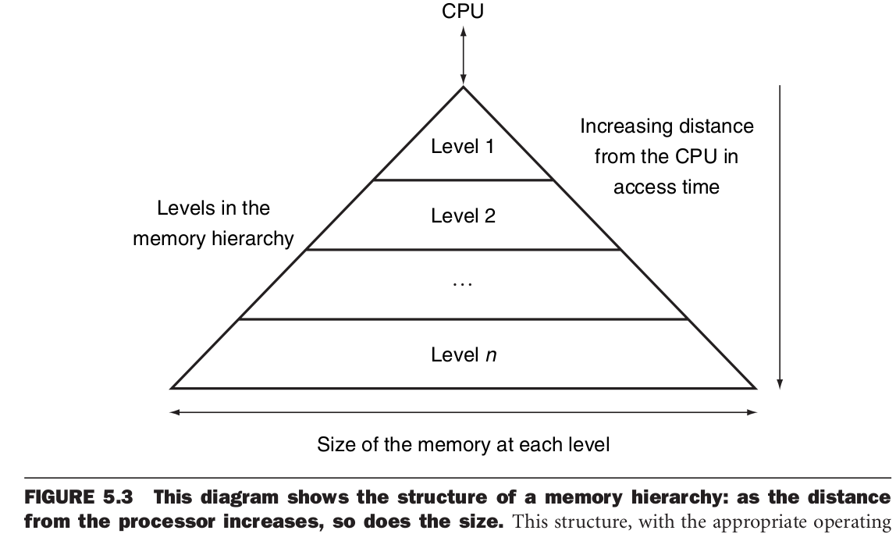

Slide 104
